Slide 1
INTRODUCTION TO PROGRAMMING LANGUAGE II(JAVA)
Fariha Zahin

Slide 2
What is Abstraction?
Definition: Abstraction is the process of hiding implementation details and showing only functionality to the user.
Purpose: Focus on what an object does instead of how it does it.
Achieved By:
Abstract Classes
Interfaces
Abstract Class – Definition & Features
Can have both abstract (without body) and concrete methods.
Can have member variables (fields).
Can have constructors.
Cannot be instantiated directly.
Partial abstraction(0-100%)

Slide 3
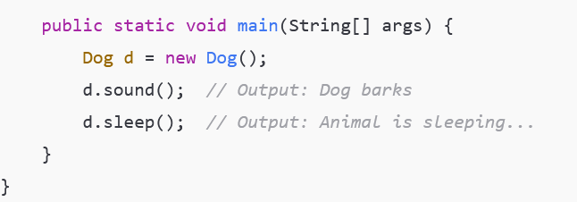
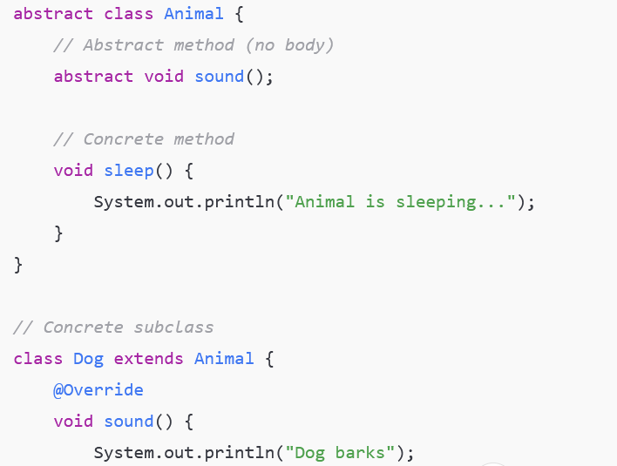
Animal is an abstract class.
It has an abstract method sound() with no body.
It also has a concrete method sleep() with implementation.
Dog is a non-abstract subclass of Animal.
Since Dog is not abstract, it must override the abstract method sound().
The method sleep() is inherited from Animal and used directly.
In the main() method, an object d of class Dog is created.
Calling d.sound() prints "Dog barks".
Calling d.sleep() prints "Animal is sleeping...".

Slide 4
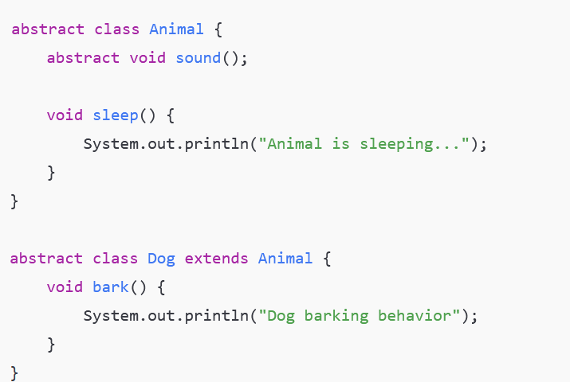
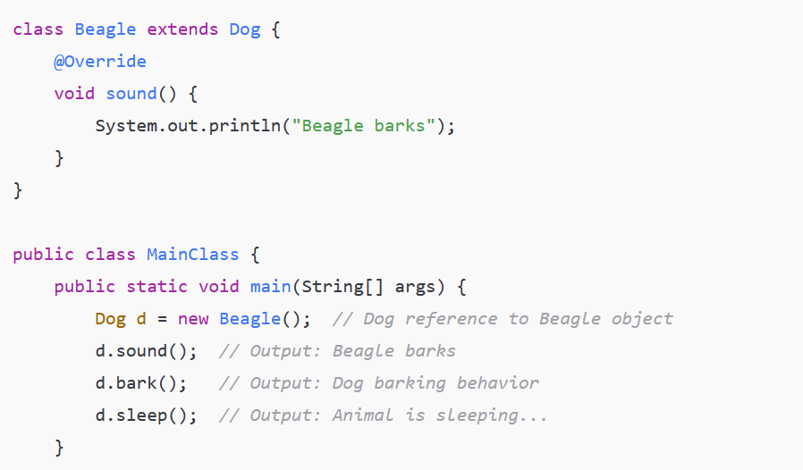
Animal is abstract with abstract sound() and concrete sleep(). Dog is an abstract subclass with bark(). Beagle is a concrete subclass overriding sound(). In main(), a Dog reference points to a Beagle object. Abstract class references can refer to subclass objects. Calling d.sound() runs Beagle’s method; d.bark() and d.sleep() come from Dog and Animal.
**Dog class is abstract, you cannot create a direct object of Dog-Java will give a compile-time error.

Slide 5
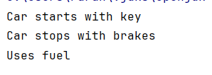
abstract class Vehicle { abstract void start(); abstract void stop(); void fuelType() { System.out.println("Uses fuel"); } } class Car extends Vehicle { void start() { System.out.println("Car starts with key"); } void stop() { System.out.println("Car stops with brakes"); } } public class Main { public static void main(String[] args) { Vehicle v = new Car(); v.start(); v.stop(); v.fuelType(); } }
One abstract class can have multiple abstract methods.
Concrete subclasses must implement all abstract methods.

Slide 6
abstract class Shape { String color; Shape(String color) { this.color = color; } abstract double area(); void displayColor() { System.out.println("Color: " + color); } } class Circle extends Shape { double radius; Circle(String color, double radius) { super(color); this.radius = radius; } double area() { return Math.PI * radius * radius; } }
Abstract classes can have constructors.
Constructor is invoked when a subclass object is created.

Slide 7

abstract class Employee { abstract void calculateSalary(); } class FullTimeEmployee extends Employee { void calculateSalary() { System.out.println("Salary: Fixed monthly salary"); } } class PartTimeEmployee extends Employee { void calculateSalary() { System.out.println("Salary: Hourly based salary"); } } public class Main { public static void main(String[] args) { Employee e1 = new FullTimeEmployee(); Employee e2 = new PartTimeEmployee(); e1.calculateSalary(); e2.calculateSalary(); } }
Abstract class references enable runtime method dispatch.
Method executed depends on object type, not reference type.

Slide 8
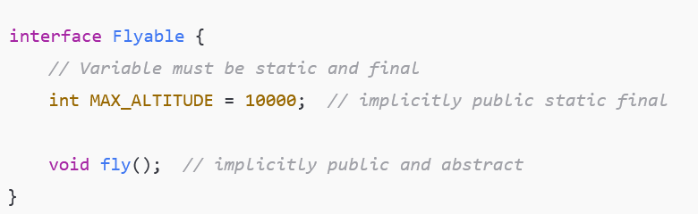
Interface – Definition & Features
All methods are implicitly public and abstract.
Variables will be constants (public static final).
Supports multiple inheritance.
Cannot have constructors or instance fields
100% abstraction.
A class can implement an interface

Slide 9
interface Bank { double INTEREST_RATE = 5.5; void calculateInterest(); } class CityBank implements Bank { public void calculateInterest() { System.out.println("Interest Rate: " + INTEREST_RATE + "%"); } }
Interface variables are public static final by default.
Methods must be implemented as public.

Slide 10

interface Shape{ double pi = 3.1416; double area(); } class Circle implements Shape{ double r=2; public double area() { return pi*r*r; } } public class Main { public static void main(String[] args) { Circle c = new Circle(); System.out.println(c.area());; System.out.println(Circle.pi); System.out.println(Shape.pi); } }
Every field in an interface is implicitly public static final (constant)
• Constants can be accessed using interface name (preferred) or implementing class name

Slide 11
interface Printable { void print(); } interface Scannable { void scan(); } class Printer implements Printable, Scannable { public void print() { System.out.println("Printing document"); } public void scan() { System.out.println("Scanning document"); } }
Java supports multiple inheritance through interfaces.

Slide 12

interface Payment { void pay(); } class CreditCardPayment implements Payment { public void pay() { System.out.println("Paid using credit card"); } } class MobileBankingPayment implements Payment { public void pay() { System.out.println("Paid using mobile banking"); } } public class Main { public static void main(String[] args) { Payment p1 = new CreditCardPayment(); p1.pay(); Payment p2 = new MobileBankingPayment(); p2.pay(); } }
Interface references behave like abstract class references.

Slide 13
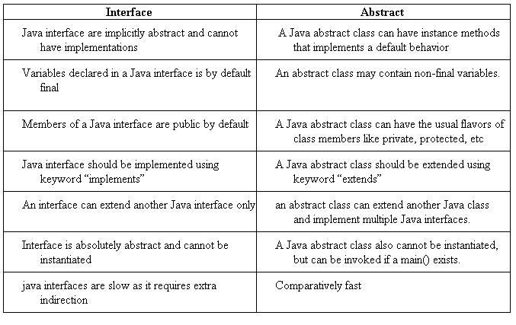
Key Differences: Abstract Class vs Interface

Slide 14
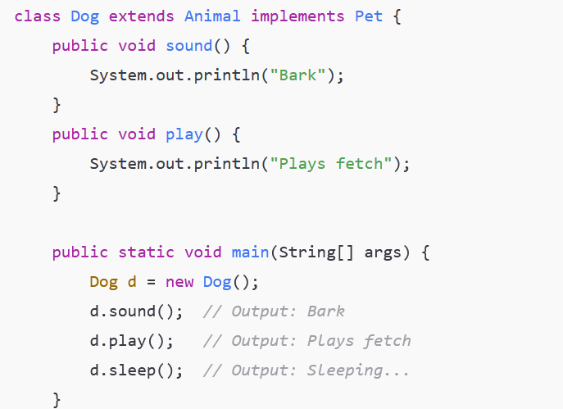
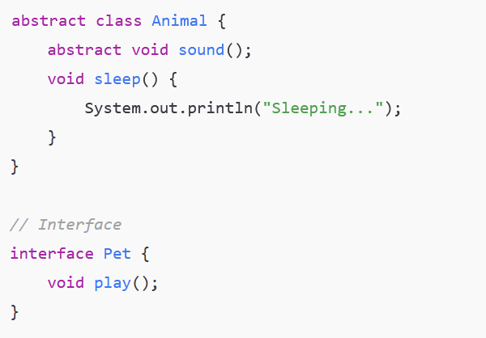
Animal is an abstract class with abstract method sound() and concrete method sleep(). Pet is an interface with method play(). Dog is a concrete class that extends Animal and implements Pet. Dog overrides sound() and play() methods. In main(), a Dog object d is created. Calling d.sound() prints "Bark". Calling d.play() prints "Plays fetch". Calling d.sleep() prints "Sleeping...".

Slide 15
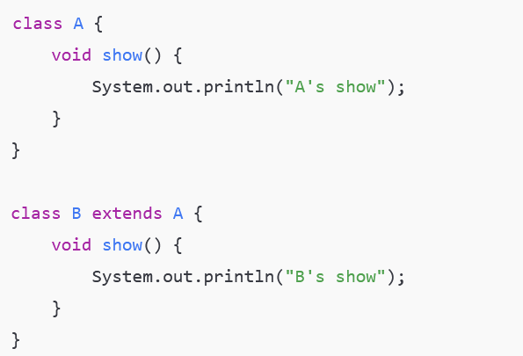
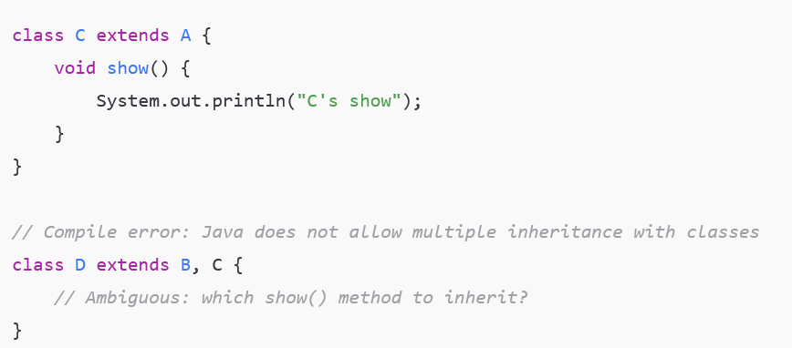
What is the Diamond Problem?
The Diamond Problem occurs in multiple inheritance when a class inherits the same method from two different parent classes or interfaces.
This causes ambiguity: which parent’s method should the child inherit or execute?
In languages like C++, this can lead to conflicts and complexity.
Java avoids the diamond problem with classes by not allowing multiple class inheritance.
However, with interfaces, default methods can cause a similar ambiguity.
Java requires the implementing class to explicitly override conflicting default methods to resolve this.

Slide 16

interface A { default void show() { System.out.println("Interface A"); } } interface B { default void show() { System.out.println("Interface B"); } } class Demo implements A, B { public void show() { A.super.show(); } } public class Main { public static void main(String[] args) { Demo d = new Demo(); d.show(); } }
Solution to Diamond Problem
Java forces explicit override to resolve default method conflicts.

Slide 17
Why Interfaces Support Multiple Inheritance
Java does not allow multiple inheritance with classes to avoid complexity and ambiguity (like the "Diamond Problem").
However, Java allows a class to implement multiple interfaces because interfaces only declare method signatures without implementation (except default methods).
This means a class can inherit method contracts from multiple interfaces without conflicts in code behavior.
Interfaces provide a way to achieve multiple inheritance of type safely and clearly.

Slide 18
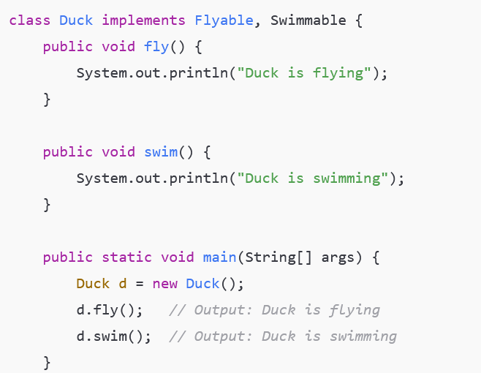
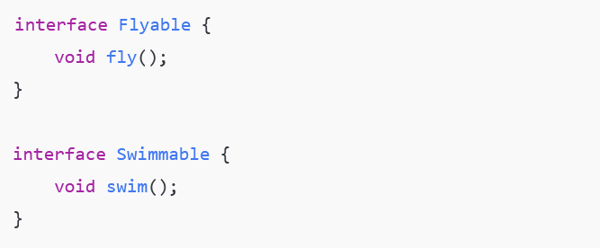
Flyable and Swimmable are interfaces declaring methods. Duck class implements both interfaces, providing implementations for fly() and swim(). This demonstrates multiple inheritance of behavior signatures via interfaces. If Java allowed multiple class inheritance, conflicts could arise. Interfaces avoid that by having no method body to conflict.

